Slide 1
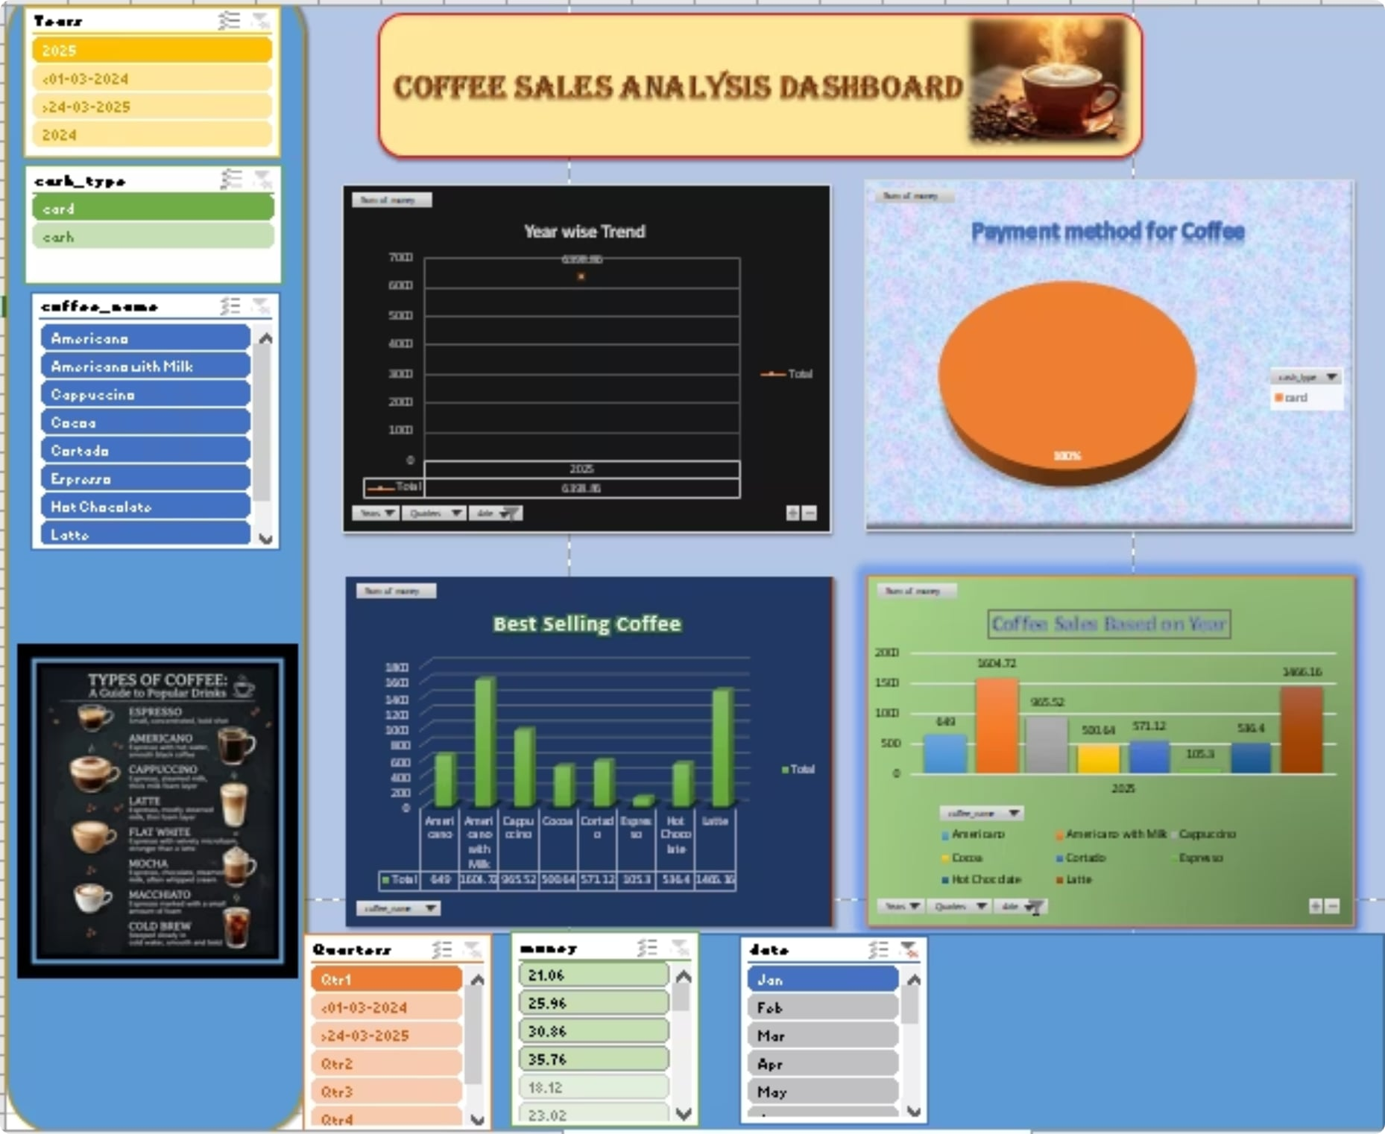
Interactive Coffee Sales Dashboard — Overview
This pack contains an interactive dashboard and an accompanying file for stakeholders and analysts. Use the dashboard to explore sales by year, coffee type, payment method and top-selling SKUs. The accompanying file includes the cleaned dataset, filters, and configuration notes for repeatable analysis.

Slide 2
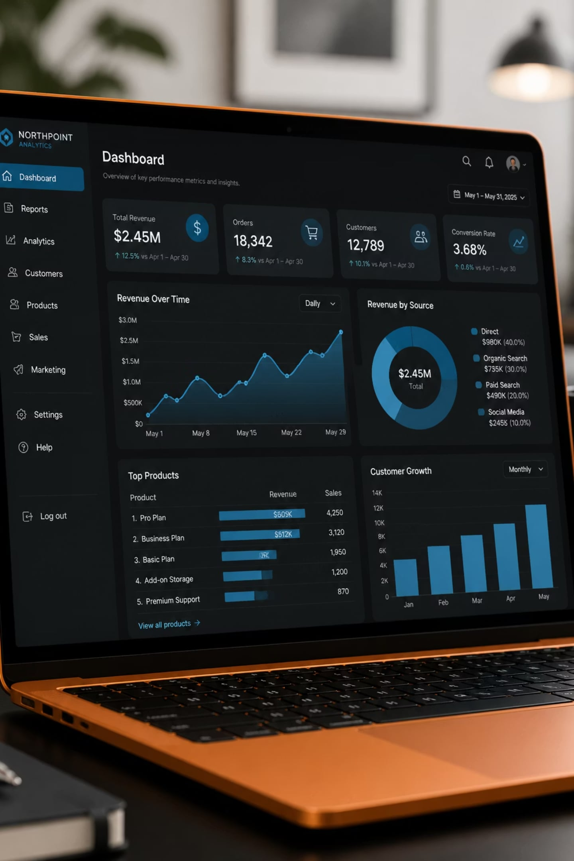

What’s included
Interactive dashboard (filters, charts, drill-downs) — live or embedded
Downloadable data file (CSV / XLSX) with schema and sample queries
Documentation: glossary, filter logic, and steps to reproduce visuals
Theme accents: #E5E5E0, #D3C1B6, #BAB6AA — applied across visuals for consistency.

Slide 3
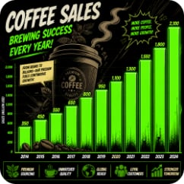
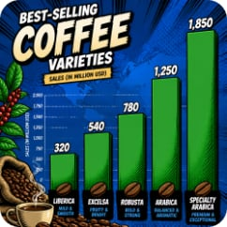
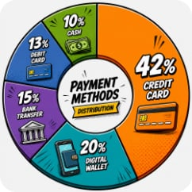
Key dashboard views
Year-wise Trend
Top-Selling SKUs
Payment Method Mix
Monthly and annual trend lines with year selectors to compare periods and seasonality effects.
Ranked sales by coffee type with volume and revenue toggle, and a detailed SKU drill-down.
Breakdown by cash, card and digital wallets with filter to view by store or region.

Slide 4


Interactive features & filters
Core filters: Date range (day → year), Store/Region, Coffee type, Payment method, and Customer segment. Interactions: cross-filtering, tooltip details, top-N selectors, and exportable filtered datasets.
Tip: Use multi-select on Coffee Type to compare blends versus single-origin performance.

Slide 5

Inspect Visuals
Export & Share
Select Filters
Follow this simple workflow to convert insight into action: pick filters, identify anomalies or opportunities, then export the data and annotated chart for reports or meetings.

Slide 6
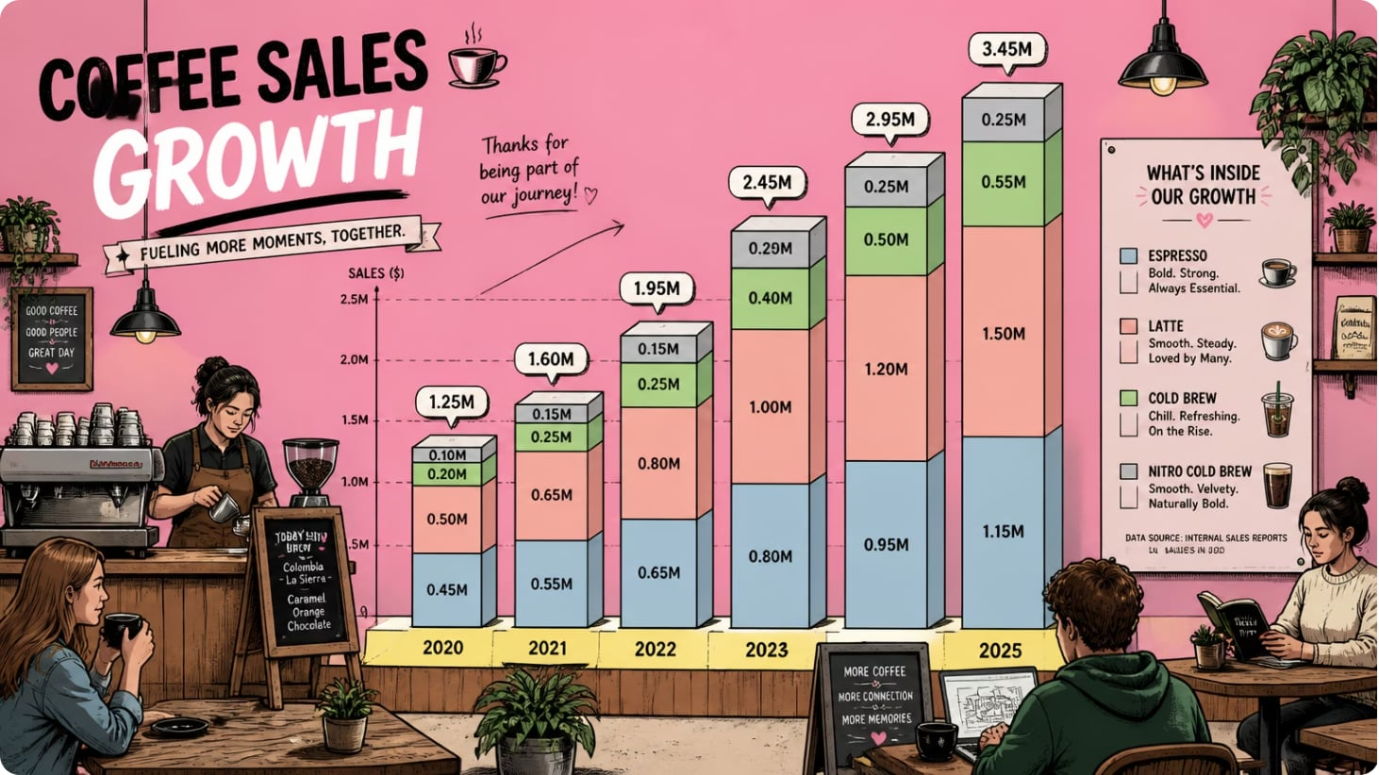
Sales by Year & Type
The stacked view reveals composition changes across years — look for category shifts (e.g., increase in lattes or cold brews). Use the hover details to see unit volumes and average price per cup.
Action: Filter to last 12 months to isolate recent trends.
Insight: Check margins per SKU for targeted promotions.

Slide 7
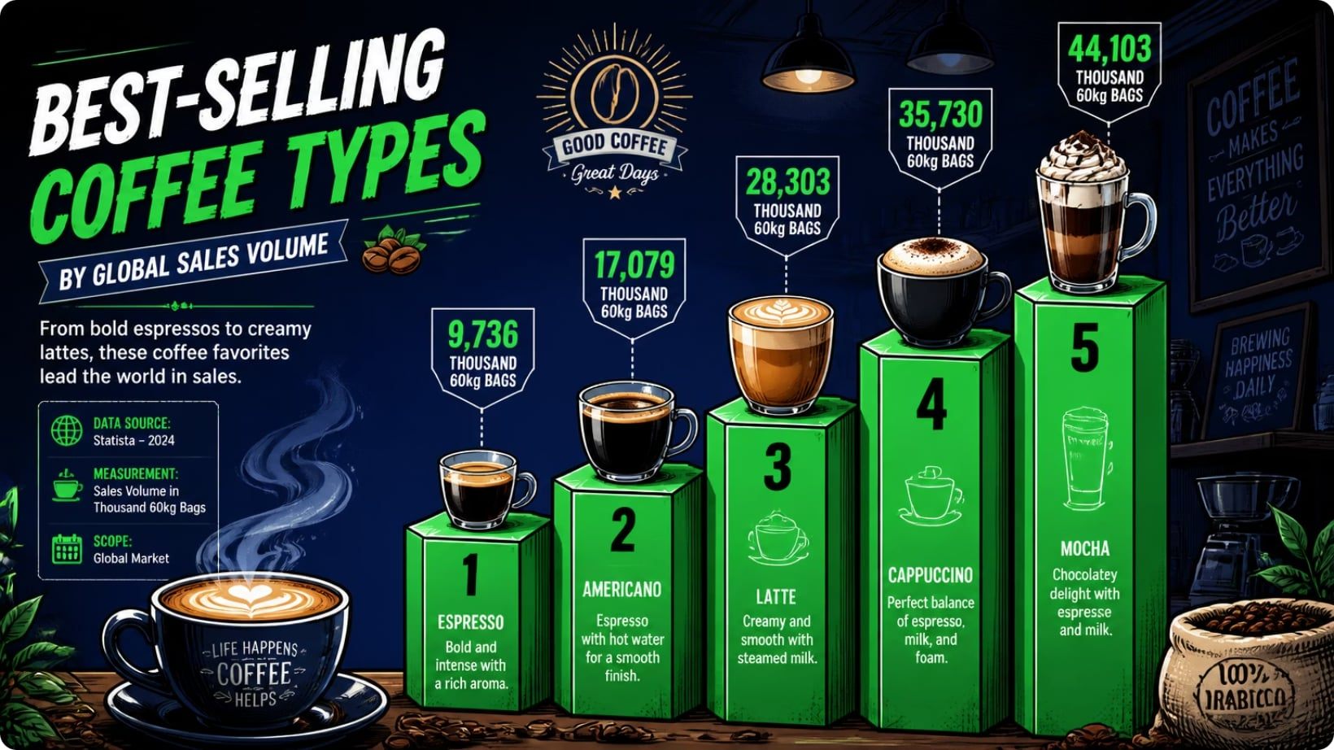
Top-Selling Coffee — Quick Analysis
The top 5 SKUs account for the majority of volume. Use the dashboard to:
Compare unit sales vs revenue to spot high-margin items
Identify stores where top SKUs underperform
Design targeted promotions for mid-performing SKUs

Slide 8
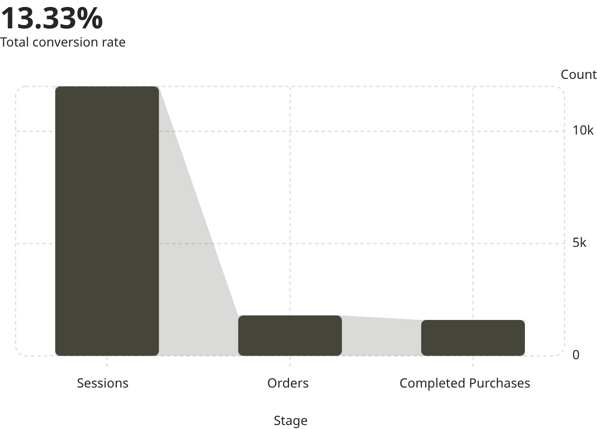
Conversion Snapshot (Example)
Example funnel illustrates conversion from visits to completed purchases. Use the dashboard to slice this by store and payment method to find drop-off points.
Improve upsell prompts at order stage
Investigate declined transactions by payment type

Slide 9
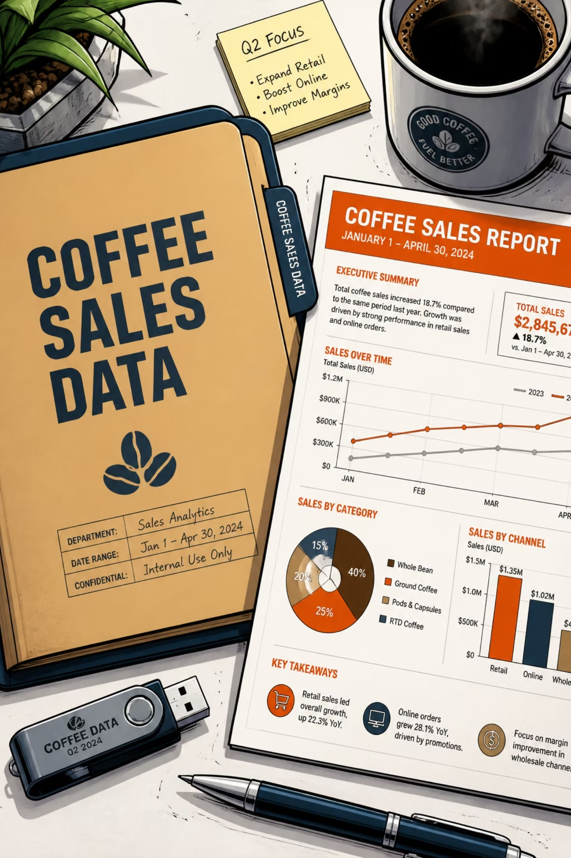
Accompanying file — contents & how to use
The downloadable file includes:
Cleaned transactional dataset (timestamp, store, SKU, qty, price, payment_method)
Data dictionary and transformation steps (ETL notes)
Pre-built filter definitions and calculated fields (ARPU, avg ticket, margin)
Sample SQL queries and export-ready CSVs for reporting
Delivery: Provide as ZIP with dashboard config, or link to shared drive for continuous refresh.

Slide 10


Next steps & recommended actions
Immediate actions to operationalise insights:
Share dashboard with store managers and schedule a 30-min walkthrough
Approve export of last 6 months for margin review on top 10 SKUs
Set up weekly automated report and one alert for sudden drop in conversion
Ready to deliver: I can export the dashboard package and prepare the zipped file for distribution — confirm preferred format (PDF + XLSX or dashboard+CSV).

